Slide 1
Data Structures and Algorithms
Data Structures and Algorithms
Lecture 4 – Minimum Spanning Tree
Miao Zhang

Slide 2
Problem: Laying Telephone Wire
Central office

Slide 3
Wiring: Naive Approach
Central office
Expensive!

Slide 4
Wiring: Better Approach
Central office
Minimize the total length of wire connecting the customers

Slide 5
Minimum-cost spanning trees
Suppose you have a connected undirected graph with a weight (or cost) associated with each edge
The cost of a spanning tree would be the sum of the costs of its edges
A minimum-cost spanning tree is a spanning tree that has the lowest cost
16
16
A
B
A
B
21
11
6
11
6
19
5
5
F
C
F
C
33
14
10
E
18
D
E
18
D
A connected, undirected graph
A minimum-cost spanning tree

Slide 6
Minimum Spanning Tree (MST)
A minimum spanning tree is a subgraph of an undirected weighted graph G, such that
It is a tree (i.e., it is acyclic)
It covers all the vertices V
Contains |V| - 1 edges
The total cost associated with tree edges is the minimum among all possible spanning trees
Not necessarily unique

Slide 7
How Can We Generate a MST?
9
b
9
b
a
2
6
a
2
6
d
d
4
5
4
5
5
4
5
4
5
e
5
e
c
c

Slide 8
Spanning Trees
A spanning tree of a graph is just a subgraph that contains all the vertices and is a tree.
A graph may have many spanning trees.
Graph A
Some Spanning Trees from Graph A
or
or
or

Slide 9
Complete Graph
All 16 of its Spanning Trees

Slide 10
Algorithms for Creating the Minimum Spanning Tree
Prim's Algorithm
Kruskal's Algorithm

Slide 11
Two Algorithms
Prim: (build tree incrementally)
Pick lower cost edge connected to known (incomplete) spanning tree that does not create a cycle and expand to include it in the tree
Kruskal: (build forest that will finish as a tree)
Pick lower cost edge not yet in a tree that does not create a cycle and expand to include it somewhere in the forest

Slide 12
Prim’s Algorithm
We pick an arbitrary vertex s and we grow the MST as a cloud of vertices, starting from s
We store with each vertex v a label d(v) = the smallest weight of an edge connecting v to a vertex in the cloud
At each step:
We add to the cloud the vertex u outside the cloud with the smallest distance label
We update the labels of the vertices adjacent to u

Slide 13
Prim’s algorithm
Idea：
N = ( V , E ) is a connected graph with n nodes. Suppose U is the nodes set of MST， TE is the edge set of MST；
Initial，U = { u₁ } ，TE = { } ，
Repeat:
For u∈U，v∈V-U , find the minimum edge ( u’ , v’ ) in all edges ( u , v ) , and insert ( u’ , v’ ) in TE set；
Meanwhile put v’ in set U ；
Until U = V end.
TE contains n-1 edges.

Slide 14
Prim’s algorithm
Ex，
v₁
v₁
6
5
1
1
v₂
5
v₃
5
v₄
v₂
5
v₃
v₄
3
6
4
2
3
4
2
v₅
6
v₆
v₅
v₆
Initial: U = { v₁ } ，V-U = { v₂ , v₃ , v₄ , v₅ , v₆ }
TE = { }
U = { v₁ , v₃ } ，V-U = { v₂ , v₄ , v₅ , v₆ }
< v₁ , v₃ >
U = { v₁ , v₃ , v₆ } ，V-U = { v₂ , v₄ , v₅ }
< v₃ , v₆ >
U = { v₁ , v₃ , v₄ , v₆ } ，V-U = { v₂ , v₅ }
< v₆ , v₄ >
U = { v₁ , v₂ , v₃ , v₄ , v₆ } ，V-U = { v₅ }
< v₃ , v₂ >
U = { v₁ , v₂ , v₃ , v₄ , v₅ , v₆ } ，V-U = { }
< v₂ , v₅ >
****: The edge is existed between U and V-U(MST characteristics).

Slide 15
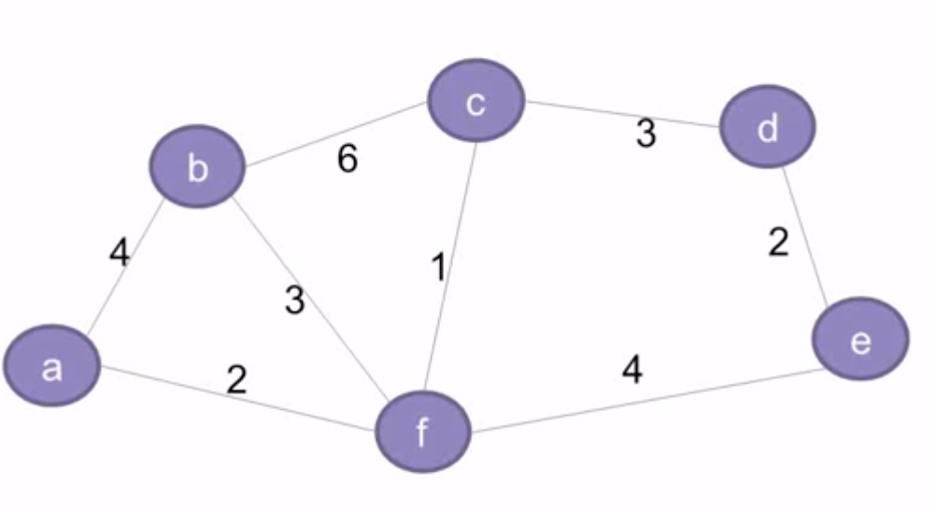

Slide 16
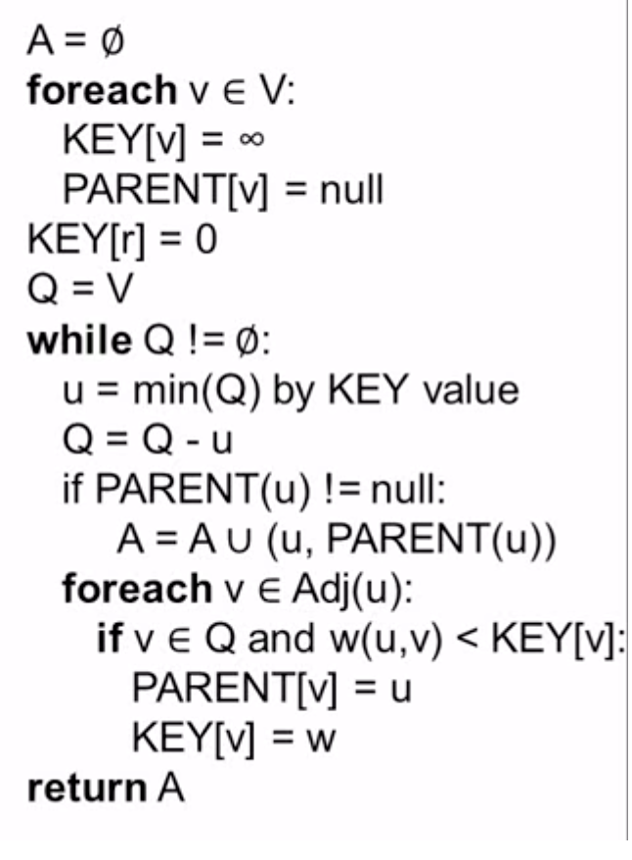
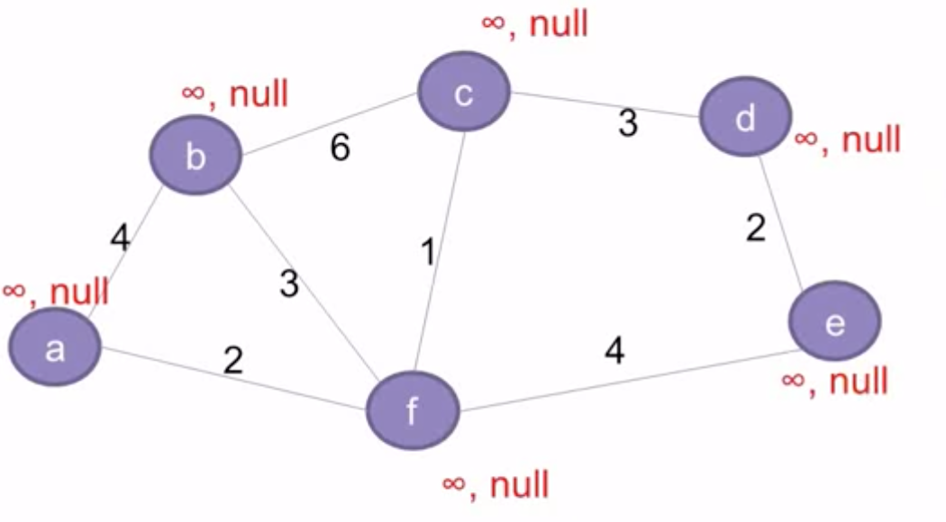
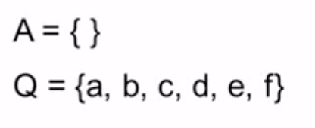

Slide 17
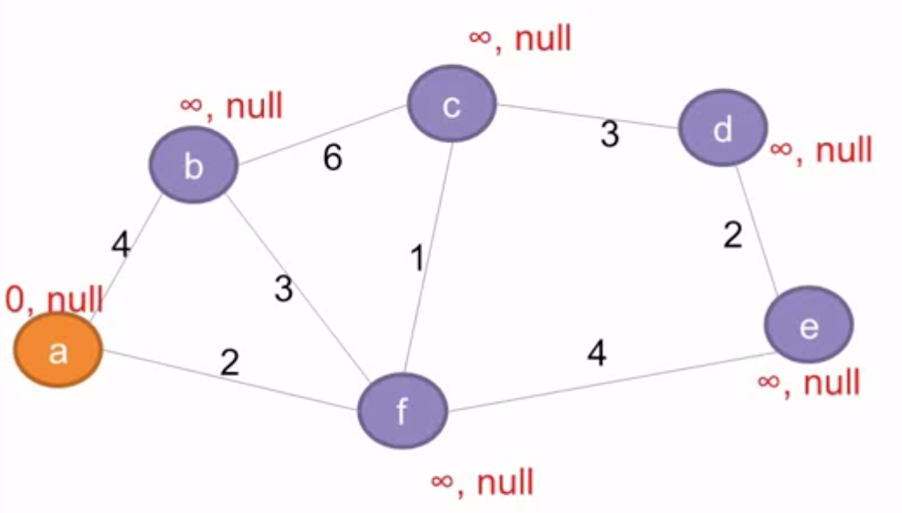

Slide 18
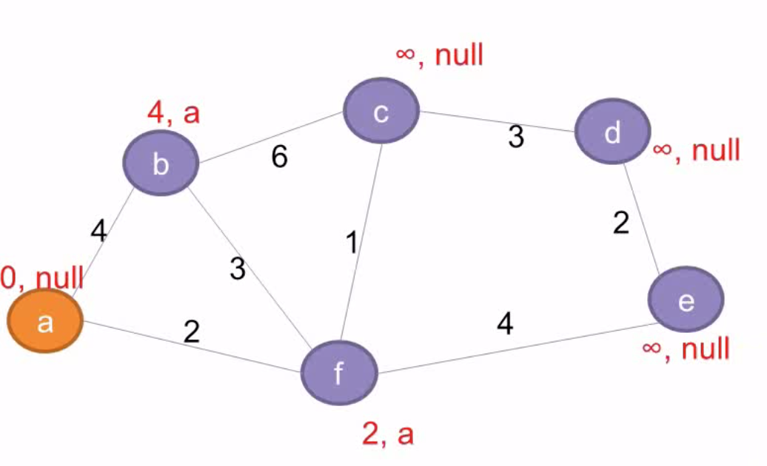

Slide 19
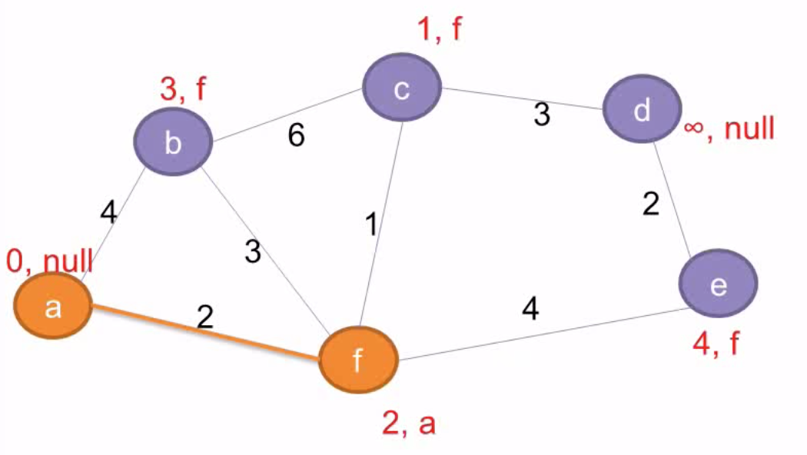
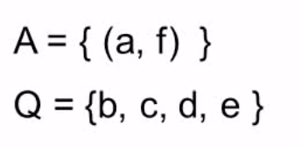

Slide 20
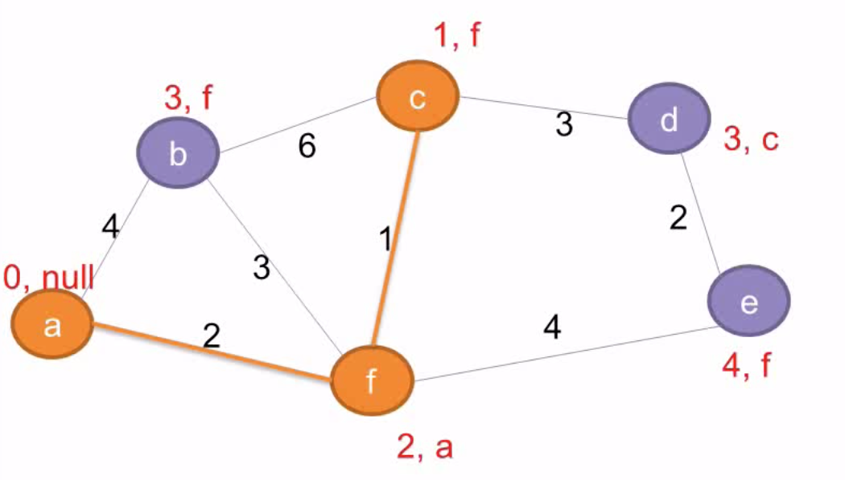
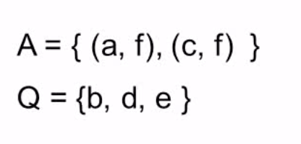

Slide 21
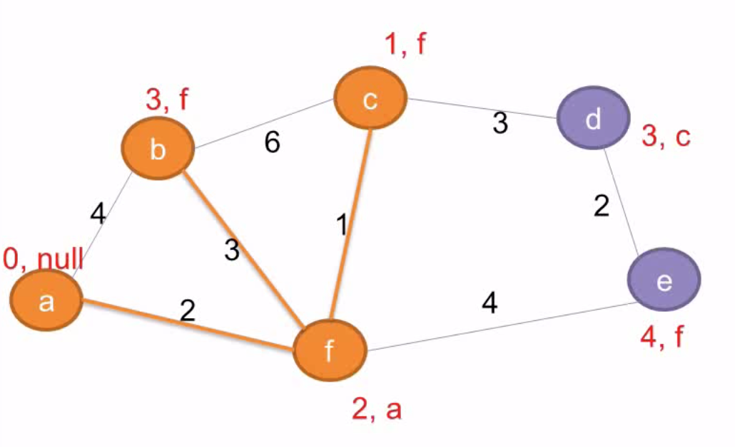
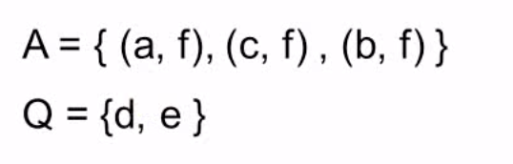

Slide 22
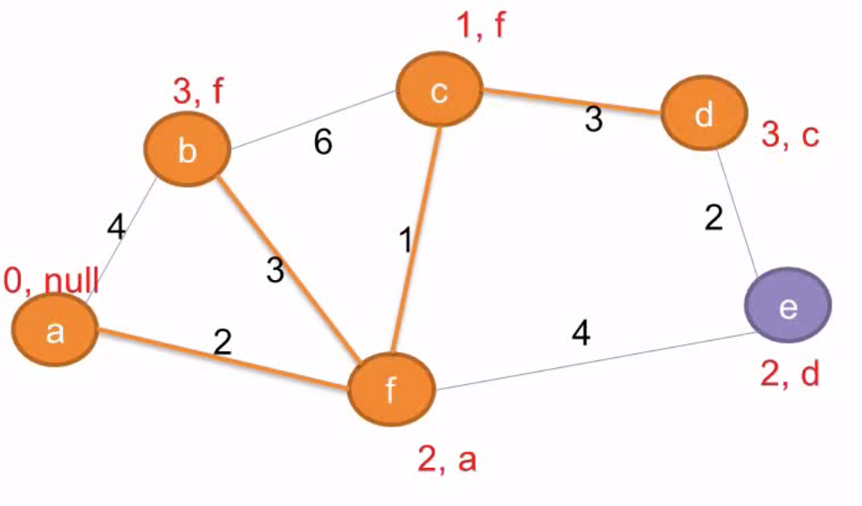
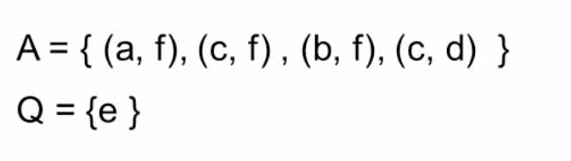

Slide 23
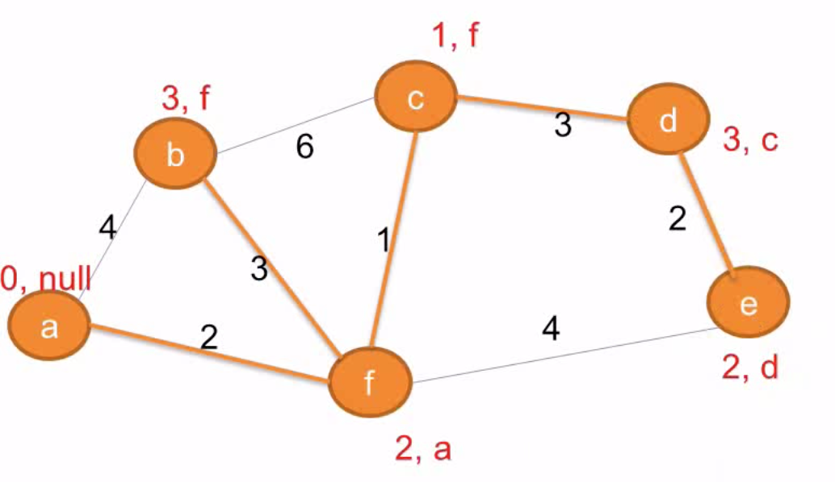
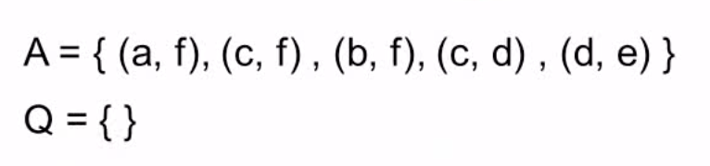

Slide 24
Prim’s Algorithm Implementation
Assume adjacency list representation
Initialize connection cost of each node to “inf” and “unmark” then
Choose one node, say v and set cost[v] = 0 and prev[v] =0
While they are unmarked nodes
Select the unmarked node u with minimum cost; mark it
For each unmarked node w adjacent to u
if cost(u,w) < cost(w) then cost(w) := cost (u,w)
prev[w] = u

Slide 25
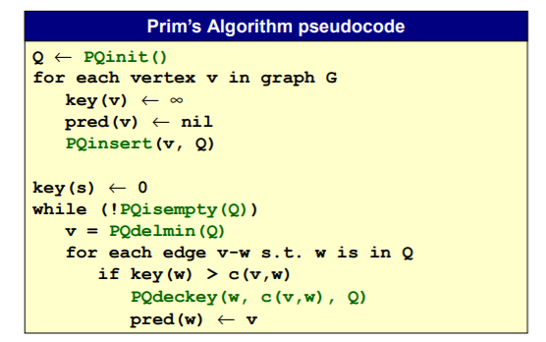
Prim’s Algorithm: Priority Queue Implementation

Slide 26
Kruskal’s Algorithm
Work with edges, rather than nodes
Two steps:
Sort edges by increasing edge weight
Select the first |V| – 1 edges that do not generate a cycle

Slide 27
Kruskal’s Algorithm
Initialize a forest of trees, each tree being a single node
Build a priority queue of edges with priority being lowest cost
Repeat until |V| -1 edges have been accepted {
Deletemin edge from priority queue
If it forms a cycle then discard it
else accept the edge – It will join 2 existing trees yielding a larger tree and reducing the forest by one tree
}
The accepted edges form the minimum spanning tree
Every step will have joined two trees in the forest together, so that at the end, there will only be one tree

Slide 28
Kruskal’s Algorithm
Sort the edges by increasing edge weight
F
3
C
edge | d_{v}
(D,E) | 1
(D,G) | 2
(E,G) | 3
(C,D) | 3
(G,H) | 3
(C,F) | 3
(B,C) | 4
edge | d_{v}
(B,E) | 4
(B,F) | 4
(B,H) | 4
(A,H) | 5
(D,F) | 6
(A,B) | 8
(A,F) | 10
10
A
4
3
8
4
5
B
6
D
4
4
H
2
1
3
G
E
3

Slide 29
Kruskal’s Algorithm
Select first |V|–1 edges which do not generate a cycle
F
3
C
edge | d_{v}
(D,E) | 1 | √
(D,G) | 2
(E,G) | 3
(C,D) | 3
(G,H) | 3
(C,F) | 3
(B,C) | 4
edge | d_{v}
(B,E) | 4
(B,F) | 4
(B,H) | 4
(A,H) | 5
(D,F) | 6
(A,B) | 8
(A,F) | 10
10
A
4
3
8
4
5
B
6
D
4
4
H
2
1
3
G
E
3

Slide 30
Kruskal’s Algorithm
Select first |V|–1 edges which do not generate a cycle
F
3
C
edge | d_{v}
(D,E) | 1 | √
(D,G) | 2 | √
(E,G) | 3
(C,D) | 3
(G,H) | 3
(C,F) | 3
(B,C) | 4
edge | d_{v}
(B,E) | 4
(B,F) | 4
(B,H) | 4
(A,H) | 5
(D,F) | 6
(A,B) | 8
(A,F) | 10
10
A
4
3
8
4
5
B
6
D
4
4
H
2
1
3
G
E
3

Slide 31
Kruskal’s Algorithm
Select first |V|–1 edges which do not generate a cycle
F
3
C
edge | d_{v}
(D,E) | 1 | √
(D,G) | 2 | √
(E,G) | 3 | χ
(C,D) | 3
(G,H) | 3
(C,F) | 3
(B,C) | 4
edge | d_{v}
(B,E) | 4
(B,F) | 4
(B,H) | 4
(A,H) | 5
(D,F) | 6
(A,B) | 8
(A,F) | 10
10
A
4
3
8
4
5
B
6
D
4
4
H
2
1
3
G
E
3
Accepting edge (E,G) would create a cycle

Slide 32
Kruskal’s Algorithm
Select first |V|–1 edges which do not generate a cycle
F
3
C
edge | d_{v}
(D,E) | 1 | √
(D,G) | 2 | √
(E,G) | 3 | χ
(C,D) | 3 | √
(G,H) | 3
(C,F) | 3
(B,C) | 4
edge | d_{v}
(B,E) | 4
(B,F) | 4
(B,H) | 4
(A,H) | 5
(D,F) | 6
(A,B) | 8
(A,F) | 10
10
A
4
3
8
4
5
B
6
D
4
4
H
2
1
3
G
E
3

Slide 33
Kruskal’s Algorithm
Select first |V|–1 edges which do not generate a cycle
F
3
C
edge | d_{v}
(D,E) | 1 | √
(D,G) | 2 | √
(E,G) | 3 | χ
(C,D) | 3 | √
(G,H) | 3 | √
(C,F) | 3
(B,C) | 4
edge | d_{v}
(B,E) | 4
(B,F) | 4
(B,H) | 4
(A,H) | 5
(D,F) | 6
(A,B) | 8
(A,F) | 10
10
A
4
3
8
4
5
B
6
D
4
4
H
2
1
3
G
E
3

Slide 34
Kruskal’s Algorithm
Select first |V|–1 edges which do not generate a cycle
F
3
C
edge | d_{v}
(D,E) | 1 | √
(D,G) | 2 | √
(E,G) | 3 | χ
(C,D) | 3 | √
(G,H) | 3 | √
(C,F) | 3 | √
(B,C) | 4
edge | d_{v}
(B,E) | 4
(B,F) | 4
(B,H) | 4
(A,H) | 5
(D,F) | 6
(A,B) | 8
(A,F) | 10
10
A
4
3
8
4
5
B
6
D
4
4
H
2
1
3
G
E
3

Slide 35
Kruskal’s Algorithm
Select first |V|–1 edges which do not generate a cycle
F
3
C
edge | d_{v}
(D,E) | 1 | √
(D,G) | 2 | √
(E,G) | 3 | χ
(C,D) | 3 | √
(G,H) | 3 | √
(C,F) | 3 | √
(B,C) | 4 | √
edge | d_{v}
(B,E) | 4
(B,F) | 4
(B,H) | 4
(A,H) | 5
(D,F) | 6
(A,B) | 8
(A,F) | 10
10
A
4
3
8
4
5
B
6
D
4
4
H
2
1
3
G
E
3

Slide 36
Kruskal’s Algorithm
Select first |V|–1 edges which do not generate a cycle
F
3
C
edge | d_{v}
(D,E) | 1 | √
(D,G) | 2 | √
(E,G) | 3 | χ
(C,D) | 3 | √
(G,H) | 3 | √
(C,F) | 3 | √
(B,C) | 4 | √
edge | d_{v}
(B,E) | 4 | χ
(B,F) | 4
(B,H) | 4
(A,H) | 5
(D,F) | 6
(A,B) | 8
(A,F) | 10
10
A
4
3
8
4
5
B
6
D
4
4
H
2
1
3
G
E
3

Slide 37
Kruskal’s Algorithm
Select first |V|–1 edges which do not generate a cycle
F
3
C
edge | d_{v}
(D,E) | 1 | √
(D,G) | 2 | √
(E,G) | 3 | χ
(C,D) | 3 | √
(G,H) | 3 | √
(C,F) | 3 | √
(B,C) | 4 | √
edge | d_{v}
(B,E) | 4 | χ
(B,F) | 4 | χ
(B,H) | 4
(A,H) | 5
(D,F) | 6
(A,B) | 8
(A,F) | 10
10
A
4
3
8
4
5
B
6
D
4
4
H
2
1
3
G
E
3

Slide 38
Kruskal’s Algorithm
Select first |V|–1 edges which do not generate a cycle
F
3
C
edge | d_{v}
(D,E) | 1 | √
(D,G) | 2 | √
(E,G) | 3 | χ
(C,D) | 3 | √
(G,H) | 3 | √
(C,F) | 3 | √
(B,C) | 4 | √
edge | d_{v}
(B,E) | 4 | χ
(B,F) | 4 | χ
(B,H) | 4 | χ
(A,H) | 5
(D,F) | 6
(A,B) | 8
(A,F) | 10
10
A
4
3
8
4
5
B
6
D
4
4
H
2
1
3
G
E
3

Slide 39
Kruskal’s Algorithm
Select first |V|–1 edges which do not generate a cycle
F
3
C
edge | d_{v}
(D,E) | 1 | √
(D,G) | 2 | √
(E,G) | 3 | χ
(C,D) | 3 | √
(G,H) | 3 | √
(C,F) | 3 | √
(B,C) | 4 | √
edge | d_{v}
(B,E) | 4 | χ
(B,F) | 4 | χ
(B,H) | 4 | χ
(A,H) | 5 | √
(D,F) | 6
(A,B) | 8
(A,F) | 10
10
A
4
3
8
4
5
B
6
D
4
4
H
2
1
3
G
E
3

Slide 40
Kruskal’s Algorithm
Select first |V|–1 edges which do not generate a cycle
F
3
C
edge | d_{v}
(D,E) | 1 | √
(D,G) | 2 | √
(E,G) | 3 | χ
(C,D) | 3 | √
(G,H) | 3 | √
(C,F) | 3 | √
(B,C) | 4 | √
edge | d_{v}
(B,E) | 4 | χ
(B,F) | 4 | χ
(B,H) | 4 | χ
(A,H) | 5 | √
(D,F) | 6
(A,B) | 8
(A,F) | 10
A
3
4
5
B
D
H
2
1
}
3
G
E
not
considered
Done
Total Cost = Σ d_{v} = 21

Slide 41
How to tell if an edge connects two vertices already in the same MST?
Use the UNION/FIND algorithm with parent-pointer representation.

Slide 42
Detecting Cycles
If the edge to be added (u,v) is such that vertices u and v belong to the same tree, then by adding (u,v) you would form a cycle
Therefore to check, Find(u) and Find(v). If they are the same discard (u,v)
If they are different Union(Find(u),Find(v))

Slide 43
Equivalence class
Equivalence class：Equivalence item set
Equivalence class cloud be represented by a tree.
Equivalence class contains two operations：
Find the root for each node in the tree. (FIND)
Merge two sets. (UNION)
The whole process is called “UNION/FIND algorithm”

Slide 44
Properties of trees in K’s algorithm
Vertices in different trees are disjoint
True at initialization and Union won’t modify the fact for remaining trees
Trees form equivalent classes under the relation “is connected to”
u connected to u (reflexivity)
u connected to v implies v connected to u (symmetry)
u connected to v and v connected to w implies a path from u to w so u connected to w (transitivity)

Slide 45
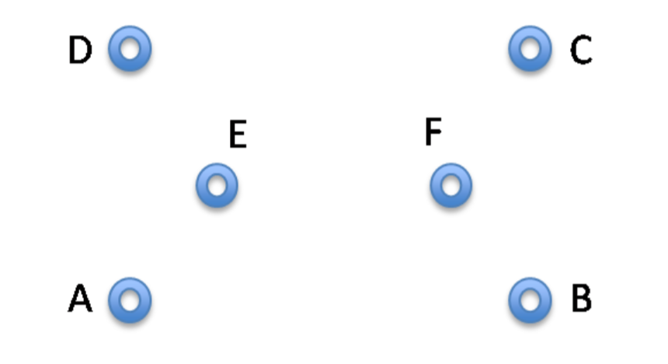
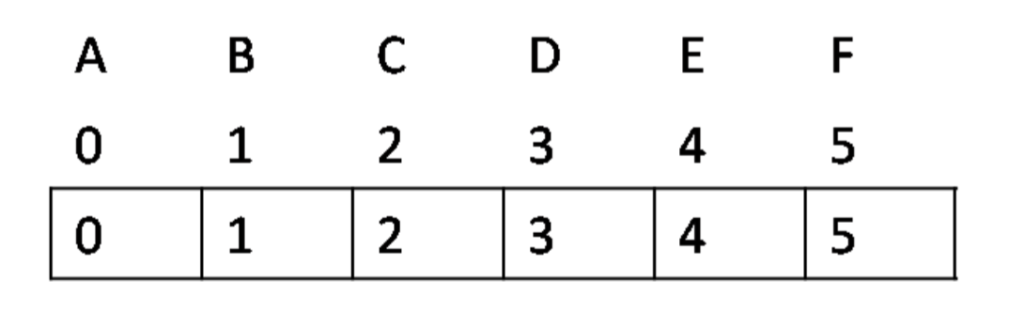
UNION/FIND algorithm
In the union-find array, UF , is in the following state

Slide 46
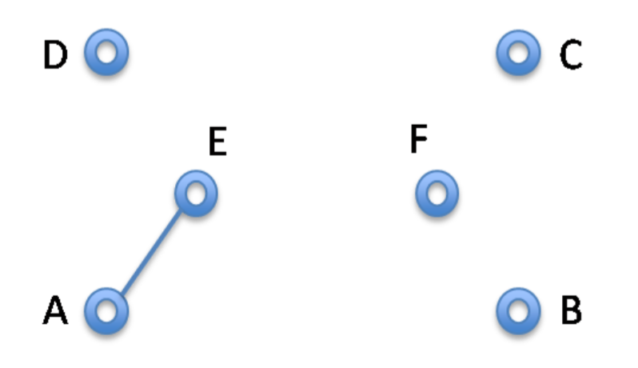

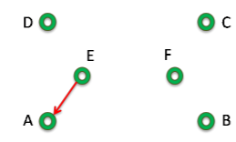
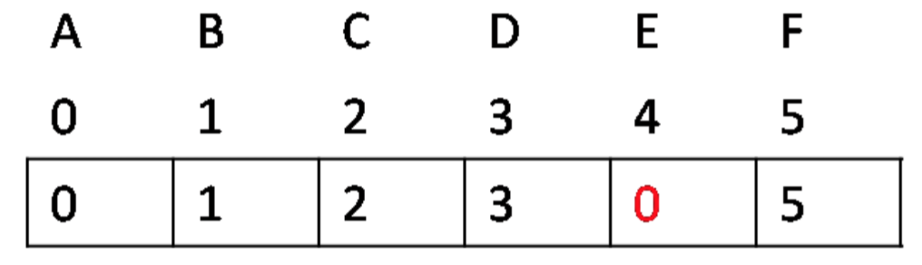
UNION/FIND algorithm

Slide 47
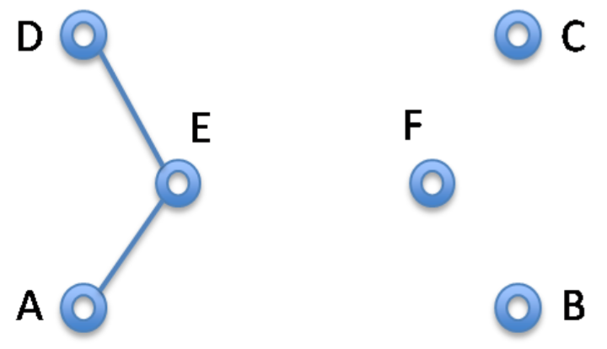
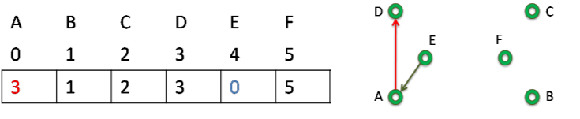
UNION/FIND algorithm

Slide 48
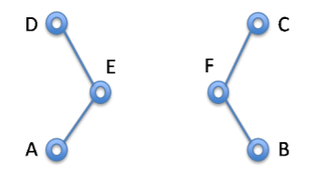
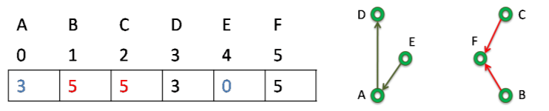
UNION/FIND algorithm

Slide 49
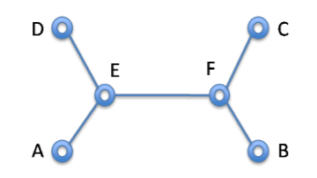
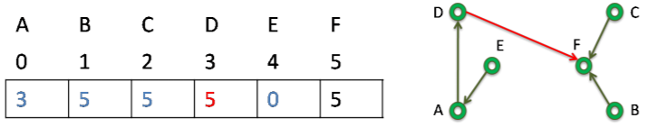
UNION/FIND algorithm

Slide 50
UNION/FIND algorithm
Static circular linked list
root[] : the index of each root node
node next[] :points to the next node in the linked list.
length[] : the number of nodes in the linked list.za

Slide 51
UNION/FIND algorithm
012345
root
0
1
2
3
4
5
012345
next
111111
length
union(0,1)
vertices
012345
002345
root
2
3
4
5
0
1
102345
next
211111
length
union(4,3)
vertices
012345

Slide 52
UNION/FIND algorithm
002445
root
2
4
3
5
0
1
102435
next
211121
length
vertices
012345
union(2,3)
004445
root
5
0
1
4
2
3
103425
next
211131
length
修改根节点
vertices
012345
52/50

Slide 53
UNION/FIND algorithm
004445
root
5
0
1
4
2
3
103425
next
211131
length
union(0,5)
vertices
012345
004440
root
4
2
3
0
5
1
503421
next
311131
length
vertices
012345

Slide 54
UNION/FIND algorithm
004440
root
4
2
3
0
5
1
503421
next
311131
length
vertices
union(2,5)
012345
444444
root
4
2
3
0
5
1
203451
next
311161
length
vertices
012345

Slide 55
UNION/FIND algorithm
class UFSets
{
private:
int n;
int* root;
int* next;
int*length;
public:
UFSets(int size);
int Find(int v);
void Union(int v,int u);
};

Slide 56
Kruskal’s Algorithm

Slide 57
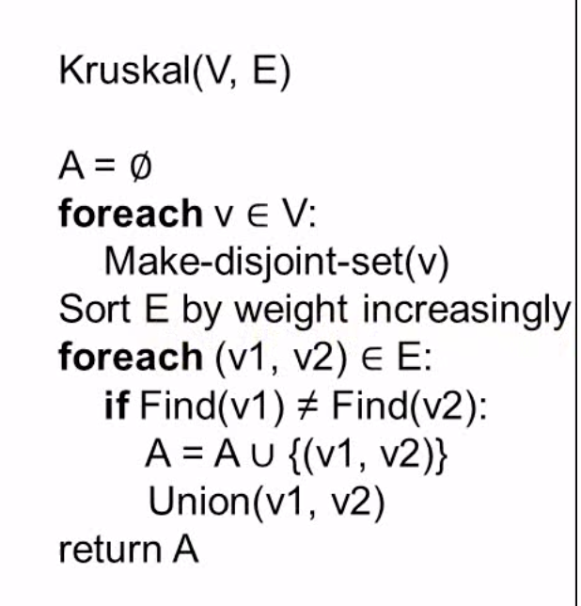
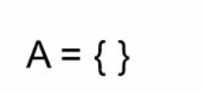
Kruskal’s Algorithm

Slide 58
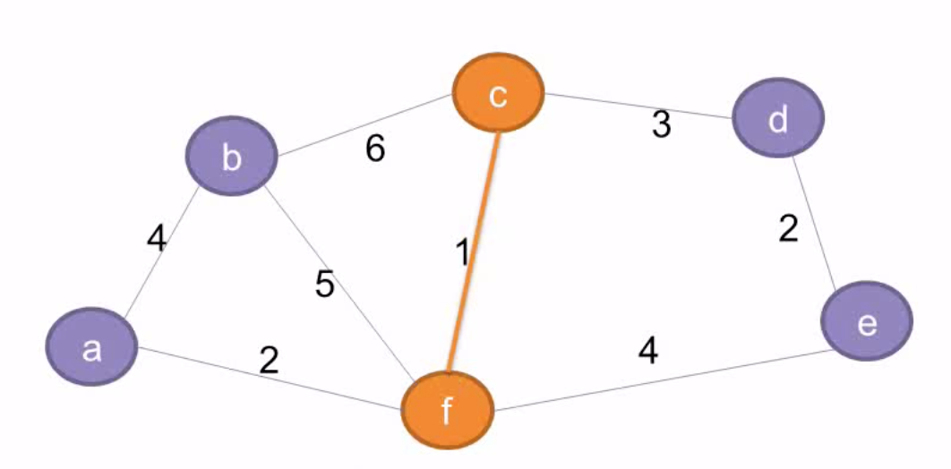
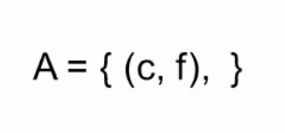
Kruskal’s Algorithm

Slide 59
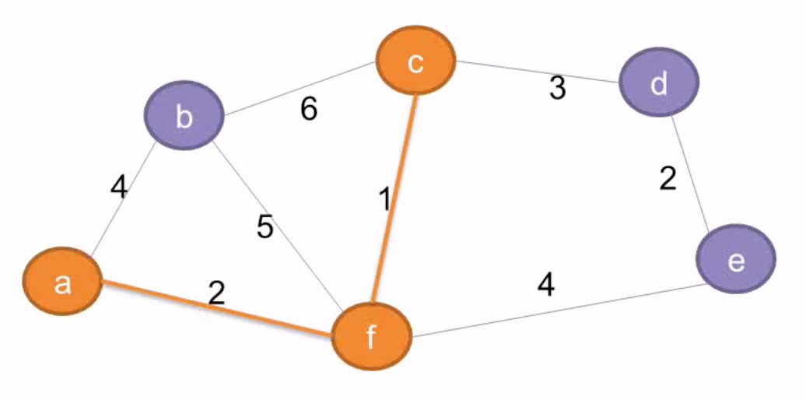
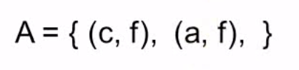
Kruskal’s Algorithm

Slide 60
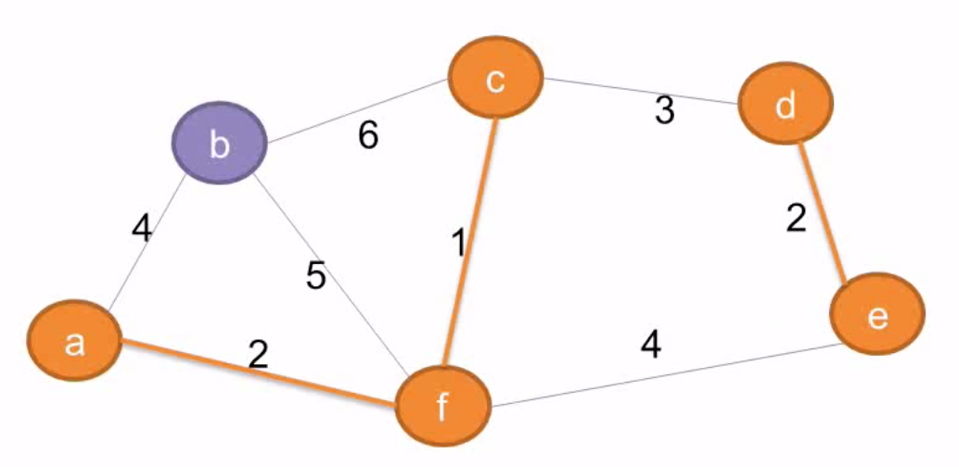
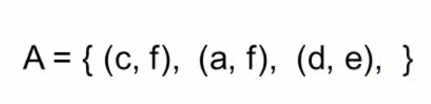
Kruskal’s Algorithm

Slide 61
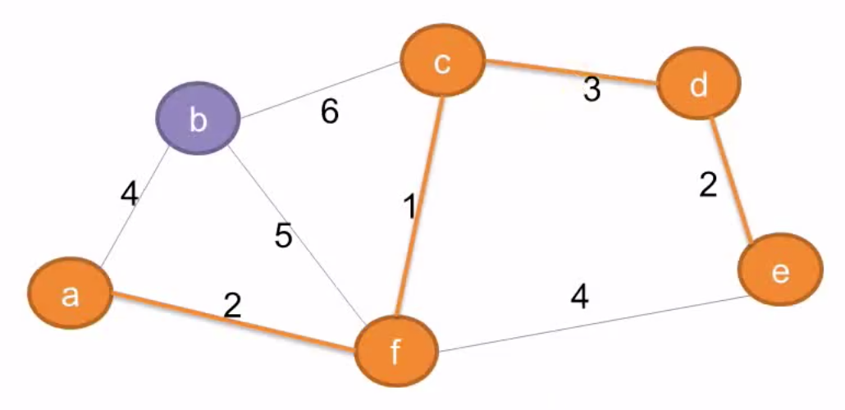
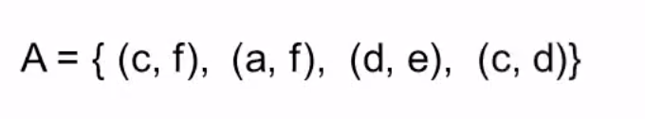
Kruskal’s Algorithm

Slide 62
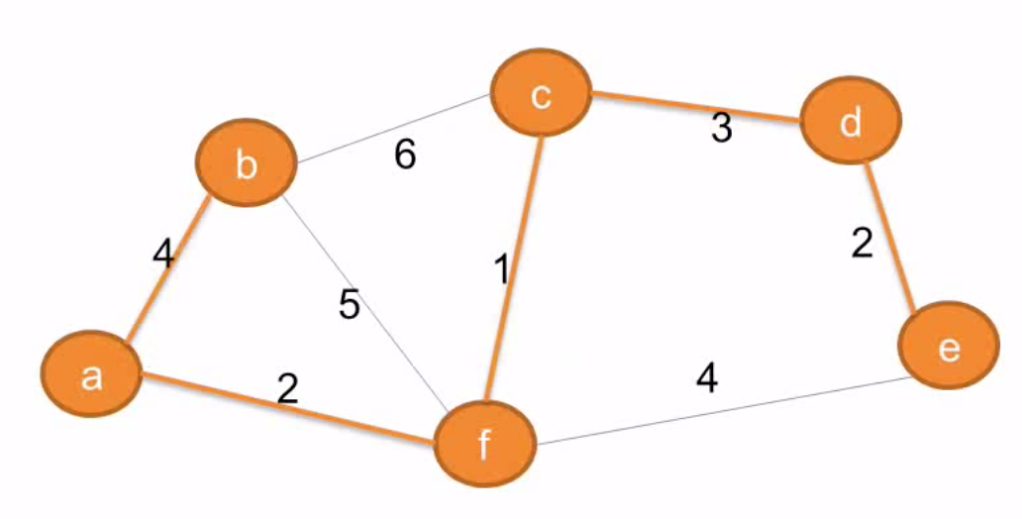
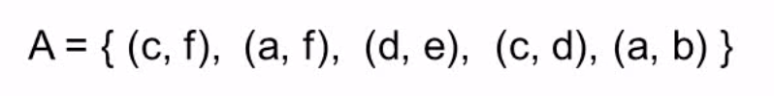

Slide 63
Kruskal算法
void Kruskal(Graph& G, Edge* &MST) { // 数组MST用于保存最小生成树的边
ParTree<int> A(G.VerticesNum()); // 等价类
MinHeap<Edge> H(G.EdgesNum()); // 最小堆
MST = new Edge[G.VerticesNum()-1]; // 为数组MST申请空间
int MSTtag = 0; // 最小生成树的边计数
bool heapEmpty;
for (int i = 0; i < G.VerticesNum(); i++) // 将图的所有边插入最小堆H中
for (Edge e = G. FirstEdge(i); G.IsEdge(e);e = G. NextEdge(e))
if (G.FromVertex(e) < G.ToVertex(e)) // 对于无向图，防止重复插入边
H.Insert(e);

Slide 64
Kruskal算法
int EquNum = G.VerticesNum(); // 开始n个顶点分别作为一个等价类
while (EquNum > 1) { // 当等价类的个数大于1时合并等价类
heapEmpty = H.isEmpty();
if (!heapEmpty)
Edge e = H.RemoveMin(); // 获得一条权最小的边
if (heapEmpty || e.weight == INFINITY) {
cout << "不存在最小生成树." <<endl;
delete [] MST; // 释放空间
MST = NULL; // MST赋为空
return;
}
int from = G.FromVertex(e); // 记录该条边的信息
int to = G.ToVertex(e);

Slide 65
Kruskal算法
if (A.Different(from,to)) { // 边e的两个顶点不在一个等价类
A.Union(from,to); // 将边e的两个顶点所在的等价类合并为一个
AddEdgetoMST(e,MST,MSTtag++); // 将边e加到MST
EquNum--; // 等价类的个数减1
}
}
}

Slide 66
Kruskal’s Algorithm Analysis
Initialize forest O(n)
Initialize heap O(m), m = |E|
Loop performed m times
In the loop one Deletemin O(logm)
Two Find, each O(logn)
One Union (at most) O(1)
So worst case O(mlogm)

Slide 67
Time Complexity
Kruskal’s algorithm: O(|E| log |E|)
Prim’s algorithm: O(|V|²)
Kruskal’s algorithm is preferable on sparse graphs, i.e., where e is very small
In practice, Kruskal has a tendency to run faster since graphs might not be dense and not all edges need to be looked at in the Deletemin operations

Slide 68
Homework
Please refer to Icourse && Touge
Due date for quiz: 23:55 September 16, 2022
Due date for homework: 23:55 September 21, 2022
Due date for lab assignment: 23:55 September 21, 2022

